Slide 1
Fine Tuning and Accuracy improvement for LSTM
Ge Zhu, Sangdi Gu

Slide 2
Recap
Retrieve Data from Alpha_Vantage including opening stock price, closing stock price, highest stock price, lowest stock price of the day and the volume.
Calculate Relative Technical Analysis Indicators:
Rolling Average for 5/10days Moving average convergence divergence(MACD), Commodity Channel Index(CCI), Average True Range – ATR, Bollinger Bands(BOLL), Moving Average for 5/10days, Momentum(30/90days), Rate of Change(30 days), Williams’ Percent Range (14 days)
Feed the data into LSTM model for training
Predict the stock price and compare with actual data to calculate accuracy

Slide 3
Model Improvement
Hyperparameter
Epoch
Number of Neurons per layer
Number of Hidden Layer
Time steps
Learning Feature
Removing repetitive or similar indicators
Model based
Bidirectional LSTM

Slide 4
Hyperparameter - Epoch
The number of epochs is a hyperparameter that defines the number times that the learning algorithm will work through the entire training dataset.
 | 30 Epoch | 50 Epoch | 100 Epoch
Apple(AAPL) | 87.65% | 91.98% | 91.18%
Facebook(FB) | 97.96% | 98.32% | 98.12%
Microsoft(MSFT) | 97.41% | 97.27% | 95.93%
Google(GOOGL) | 94.45% | 95.21% | 95.38%
Disney(DIS) | 94.72% | 95.19% | 95.63%
Celgene(CELG) | 93.56% | 91.65% | 92.45%
Visa(V) | 98.38% | 98.66% | 98.67%
Alibaba(BABA) | 96.90% | 96.18% | 95.92%
Netflix(NFLX) | 95.49% | 95.40% | 95.29%
Mastercard(MA) | 98.05% | 98.03% | 97.41%
Average | 95.46% | 95.79% | 95.60%
Training Time in total | 4500s | 7500s | 15000s

Slide 5
Hyperparameter - Number of Neuron per Layer
The number of neurons affects the learning capacity of the network. Generally, more neurons would be able to learn more structure from the problem at the cost of longer training time. More learning capacity also creates the problem of potentially overfitting the training data.
 | 100 Neuron | 200 Neuron | 400 Neuron | 600 Neuron
Apple(AAPL) | 94.69% | 91.94% | 91.98% | 84.16%
Facebook(FB) | 98.29% | 97.49% | 98.32% | 96.78%
Microsoft(MSFT) | 92.95% | 95.26% | 97.27% | 95.84%
Google(GOOGL) | 94.72% | 94.67% | 95.21% | 94.39%
Disney(DIS) | 94.61% | 94.55% | 95.19% | 93.71%
Celgene(CELG) | 92.79% | 91.82% | 91.65% | 92.67%
Visa(V) | 98.00% | 98.04% | 98.66% | 98.53%
Alibaba(BABA) | 95.52% | 96.26% | 96.18% | 96.86%
Netflix(NFLX) | 94.89% | 95.41% | 95.40% | 95.19%
Mastercard(MA) | 93.99% | 92.22% | 98.03% | 96.56%
Average | 95.05% | 94.77% | 95.79% | 94.47%

Slide 6
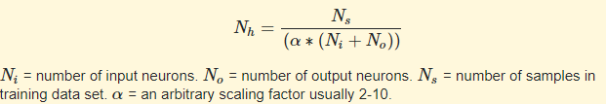
Hyperparameter - Number of Hidden Layer
The introduction of hidden layer(s) makes it possible for the network to exhibit non-linear behavior
General upper bound of number of hidden layers:
 | 4 Hidden Layer | 2 Hidden Layer
Apple(AAPL) | 92.03% | 90.97%
Facebook(FB) | 98.43% | 98.73%
Celgene(CELG) | 96.29% | 94.52%
Visa(V) | 98.67% | 99.37%
Alibaba(BABA) | 97.61% | 97.43%
Average | 96.72% | 96.20%

Slide 7
Hyperparameter - Number of Hidden Layer
As Yoshua Bengio, Head of Montreal Institute for Learning Algorithms remarks:
"Very simple. Just keep adding layers until the test error does not improve anymore."

Slide 8
Hyperparameter - Time Steps
how many units back in time you want your network to see.
 | 30 days | 60 days | 90 days
Apple(AAPL) | 91.98% | 92.51% | 87.44%
Facebook(FB) | 98.32% | 98.83% | 95.00%
Microsoft(MSFT) | 97.27% | 96.25% | 94.93%
Google(GOOGL) | 95.21% | 96.98% | 94.25%
Disney(DIS) | 95.19% | 97.42% | 94.31%
Celgene(CELG) | 91.65% | 95.98% | 92.83%
Visa(V) | 98.66% | 98.81% | 96.94%
Alibaba(BABA) | 96.18% | 97.78% | 95.35%
Netflix(NFLX) | 95.40% | 97.70% | 95.15%
Mastercard(MA) | 98.03% | 98.60% | 94.49%
Average | 95.79% | 97.09% | 94.07%
Training Time in total | 7500s | 15000s | 20000s

Slide 9
Hyperparameter – Tuning Methods
Methods used to find out Hyperparameters
Manual Search
Grid Search (Computationally exhaustive)
Random Search
Bayesian Optimization (Most practical)

Slide 10
Learning Feature
4 Major Types of indicators:
Trend: Rolling Average, MACD, Moving Average
Momentum: RSI, Momentum, Rate of change, WPR
Volume: Volume
Volatility: Bollinger Bands, APR
Rolling Average and Moving Average are identical and Momentum and rate of change are similar, this might affect the weight of them during model training.

Slide 11
Learning Feature – Removing Rolling Average
 | With Moving Average | Without
Apple(AAPL) | 92.51% | 93.19%
Facebook(FB) | 98.83% | 98.73%
Microsoft(MSFT) | 96.25% | 97.44%
Google(GOOGL) | 96.98% | 97.01%
Disney(DIS) | 97.42% | 97.44%
Celgene(CELG) | 95.98% | 95.95%
Visa(V) | 98.81% | 99.03%
Alibaba(BABA) | 97.78% | 97.74%
Netflix(NFLX) | 97.70% | 96.65%
Mastercard(MA) | 98.60% | 97.62%
Average | 97.09% | 97.08%
Training Time in total | 15000s | 15000s

Slide 12
Learning Feature – Removing Rate of Change
 | With Rate of Change | Without
Apple(AAPL) | 92.51% | 92.03%
Facebook(FB) | 98.83% | 98.43%
Microsoft(MSFT) | 96.25% | 97.85%
Google(GOOGL) | 96.98% | 97.27%
Disney(DIS) | 97.42% | 97.25%
Celgene(CELG) | 95.98% | 96.29%
Visa(V) | 98.81% | 98.67%
Alibaba(BABA) | 97.78% | 97.61%
Netflix(NFLX) | 97.70% | 97.30%
Mastercard(MA) | 98.60% | 99.00%
Average | 97.09% | 97.14%
Training Time in total | 15000s | 15000s

Slide 13
Model Based – Bidirectional LSTM
Using bidirectional will run your inputs in two ways, one from past to future and one from future to past and what differs this approach from unidirectional is that in the LSTM that runs backwards you preserve information from the future and using the two hidden states combined you are able in any point in time to preserve information from both past and future.
 | Unidirectional | Bidirectional
Apple(AAPL) | 92.03% | 90.78%
Facebook(FB) | 98.43% | 98.23%
Celgene(CELG) | 96.29% | 94.78%
Visa(V) | 98.67% | 98.71%
Alibaba(BABA) | 97.61% | 97.43%
Average | 96.72% | 95.99%

Slide 14
Brief Summary
The current model is a unidirectional LSTM model with 4 hidden layers, 400 number of neurons per layer.
The original data will be trained along with selected technical indicators for 50 epochs and using 60 time steps.
Potential Problems:
Reliability: Need to conduct test with more stocks
Stability: The model accuracy depends on the stocks. The accuracy of the stock could range from 92% to 99% - Data Related?
The improvements are not obvious, need to find the root cause to gain a larger increase in accuracy.

Slide 15
A deep learning framework for financial time series using stacked autoencoders and long-short term memory

Slide 16
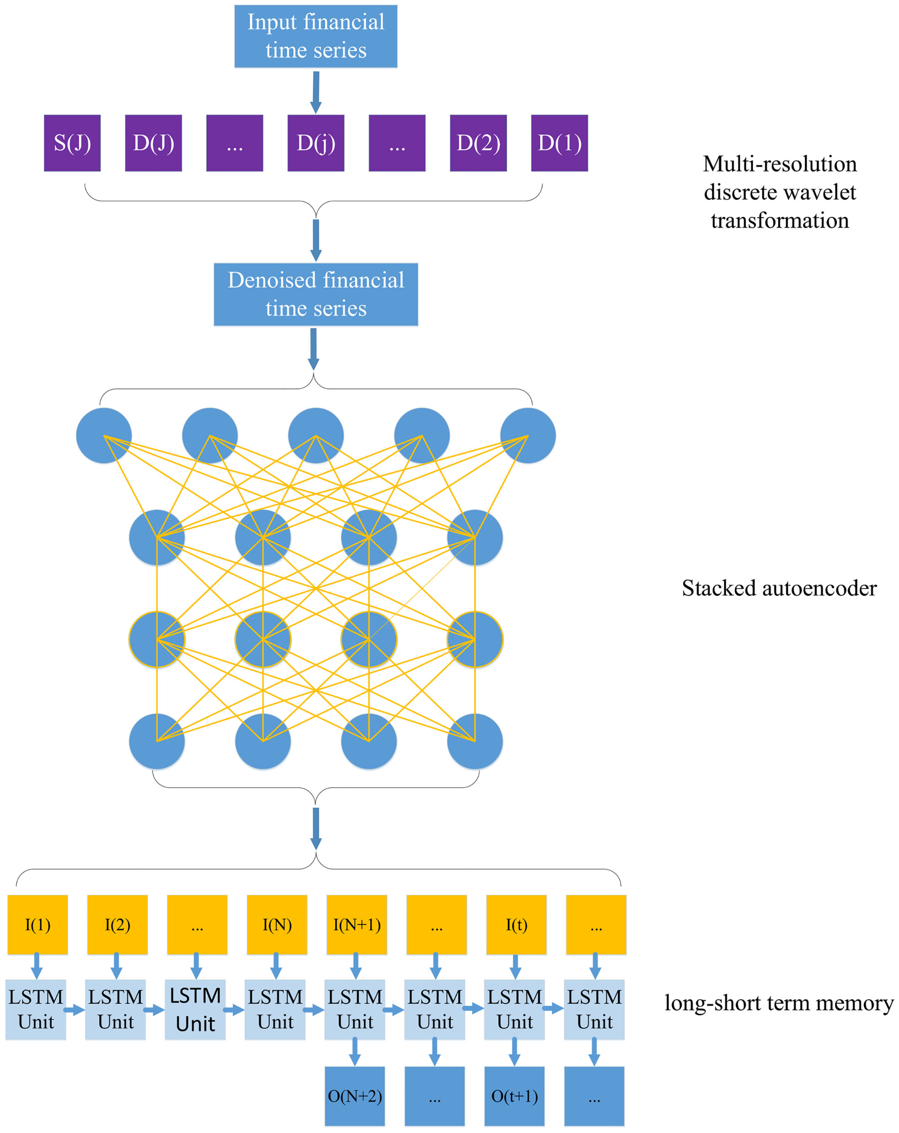
Abstract
The study presents a novel deep learning framework where wavelet transforms (WT), stacked autoencoders (SAEs) and long-short term memory (LSTM) are combined for stock price forecasting.
First, the stock price time series is decomposed by WT to eliminate noise.
Second, SAEs is applied to generate deep high-level features for predicting the stock price.
Third, high-level denoising features are fed into LSTM to forecast the next day’s closing price.
Six market indices and their corresponding index futures are chosen to examine the performance of the proposed model. Results show that the proposed model outperforms other similar models in both predictive accuracy and profitability performance.

Slide 17
Wavelet Transform
Wavelet transform is applied for data denoising in this study since it has the ability to handle the non-stationary financial time series data. The key property of wavelet transform is that it can analyze the frequency components of financial time series with time simultaneously compared with the Fourier transform. Consequently, wavelet is useful in handling highly irregular financial time series.

Slide 18
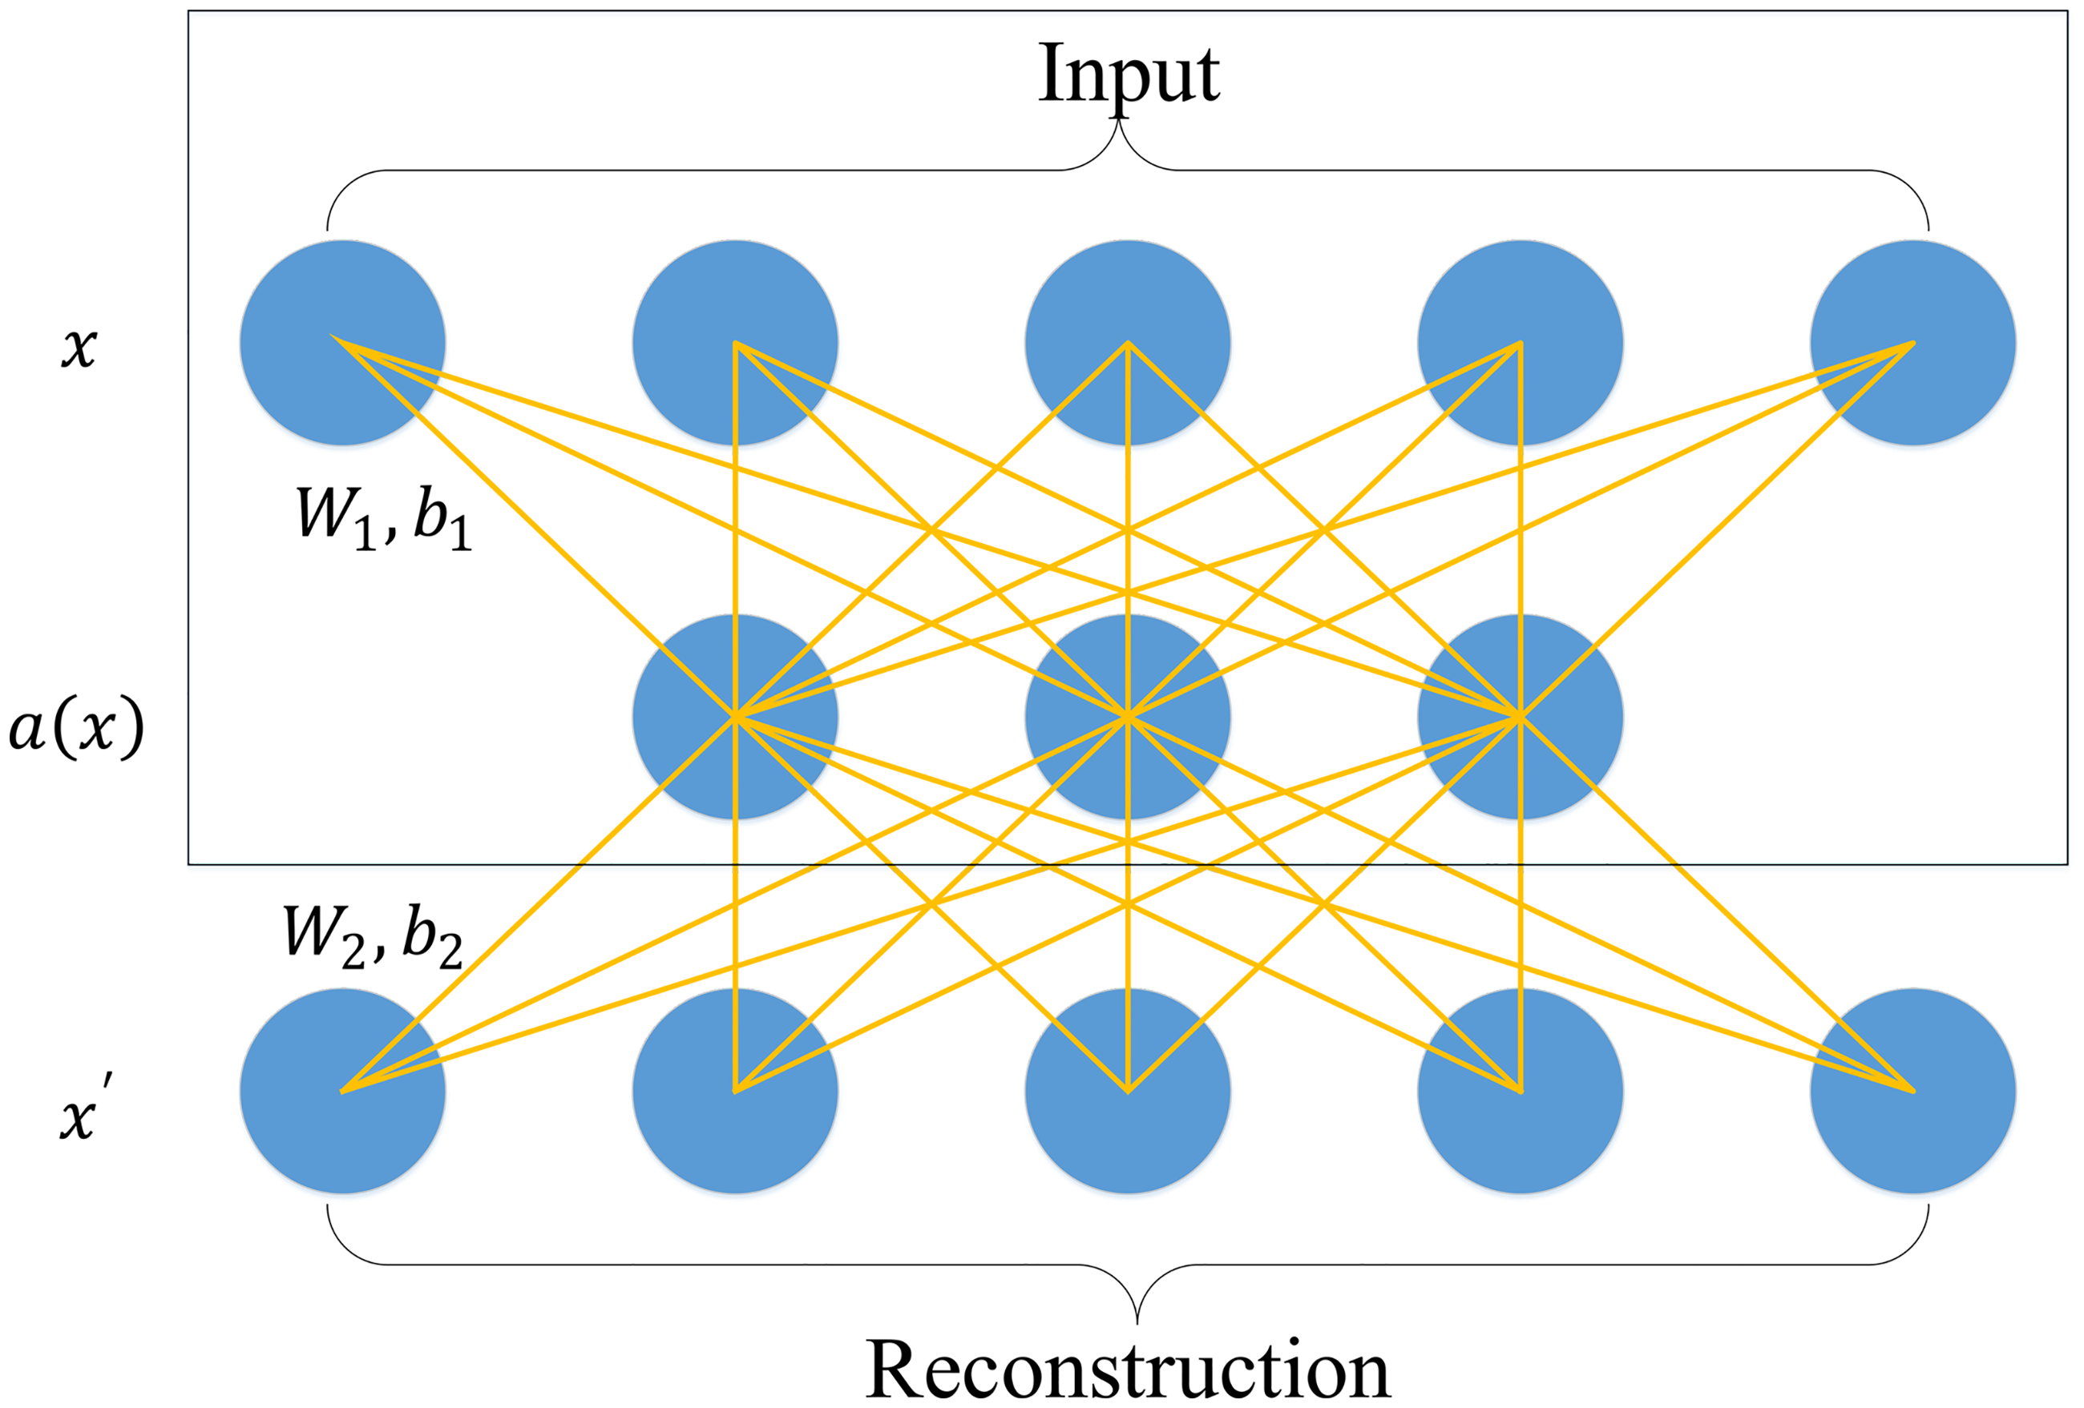

Single Layer Autoencoder
Single layer AE is a three-layer neural network. The first layer and the third layer are the input layer and the reconstruction layer with k units, respectively. The second layer is the hidden layer with n units, which is designed to generate the deep feature for this single layer AE. The aim of training the single layer AE is to minimize the error between the input vector and the reconstruction vector. The first step of the forward propagation of single layer AE is mapping the input vector to the hidden layer, while the second step is to reconstruct the input vector by mapping the hidden vector to the reconstruction layer. The two steps can be formulated as:
where x ϵ R^{k} and x' ϵ R^{k} are the input vector and the reconstructed vector, respectively. a(x) is the hidden vector generated by the single layer AE. W₁ and W₂ are the weight of the hidden layer and the reconstruction layer, respectively. b₁ and b₂ are the bias of the hidden layer and the reconstruction layer, respectively. f is the activate function

Slide 19
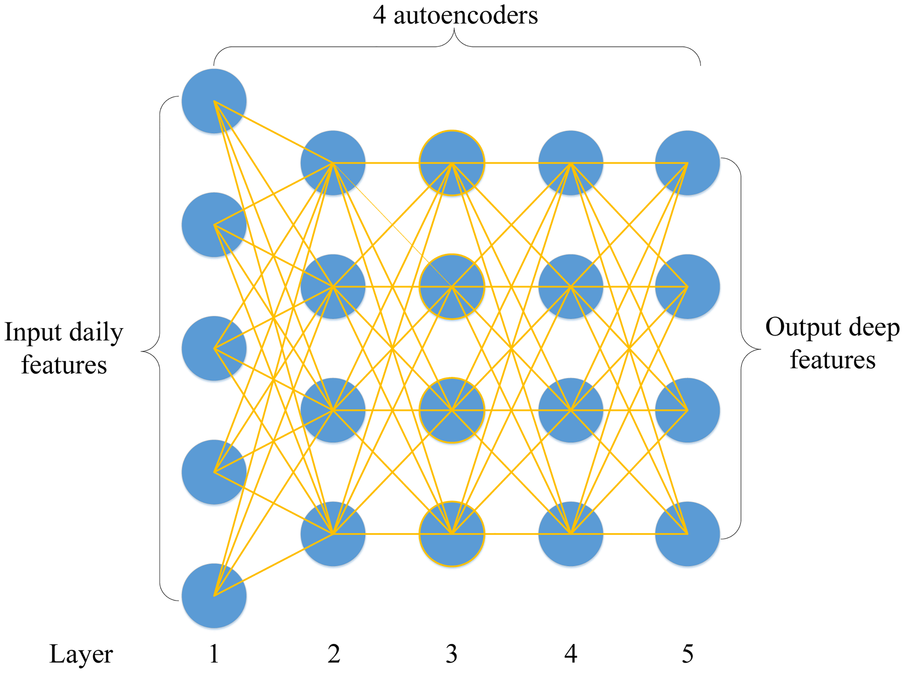
Stacked Layer Autoencoder
Stacked autoencoders is constructed by stacking a sequence of single-layer AEs layer by layer. The single-layer autoencoder maps the input daily variables into the first hidden vector. After training the first single-layer autoencoder, the reconstruction layer of the first single layer autoencoder is removed, and the hidden layer is reserved as the input layer of the second single-layer autoencoder. Generally speaking, the input layer of the subsequent AE is the hidden layer of the previous AE. Each layer is trained using the same gradient descent algorithm as a single-layer AE by solving the optimization function and feeds the hidden vector into the subsequent AE.

Slide 20
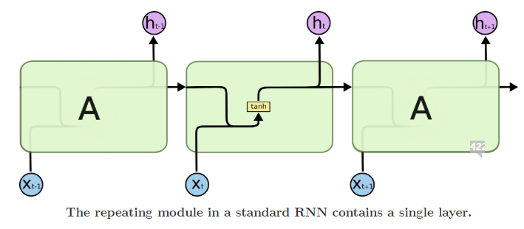
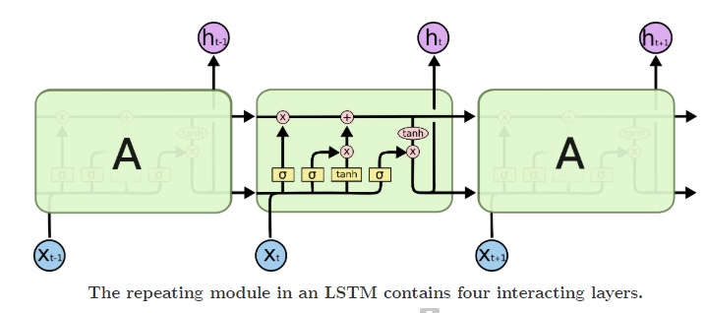
Long Short Term Memory
Long Short Term Memory networks – usually just called “LSTMs” – are a special kind of RNN, capable of learning long-term dependencies. They were introduced and were refined and popularized by many people. They work tremendously well on a large variety of problems, and are now widely used.
LSTMs are explicitly designed to avoid the long-term dependency problem. Remembering information for long periods of time is practically their default behavior, not something they struggle to learn!

Slide 21
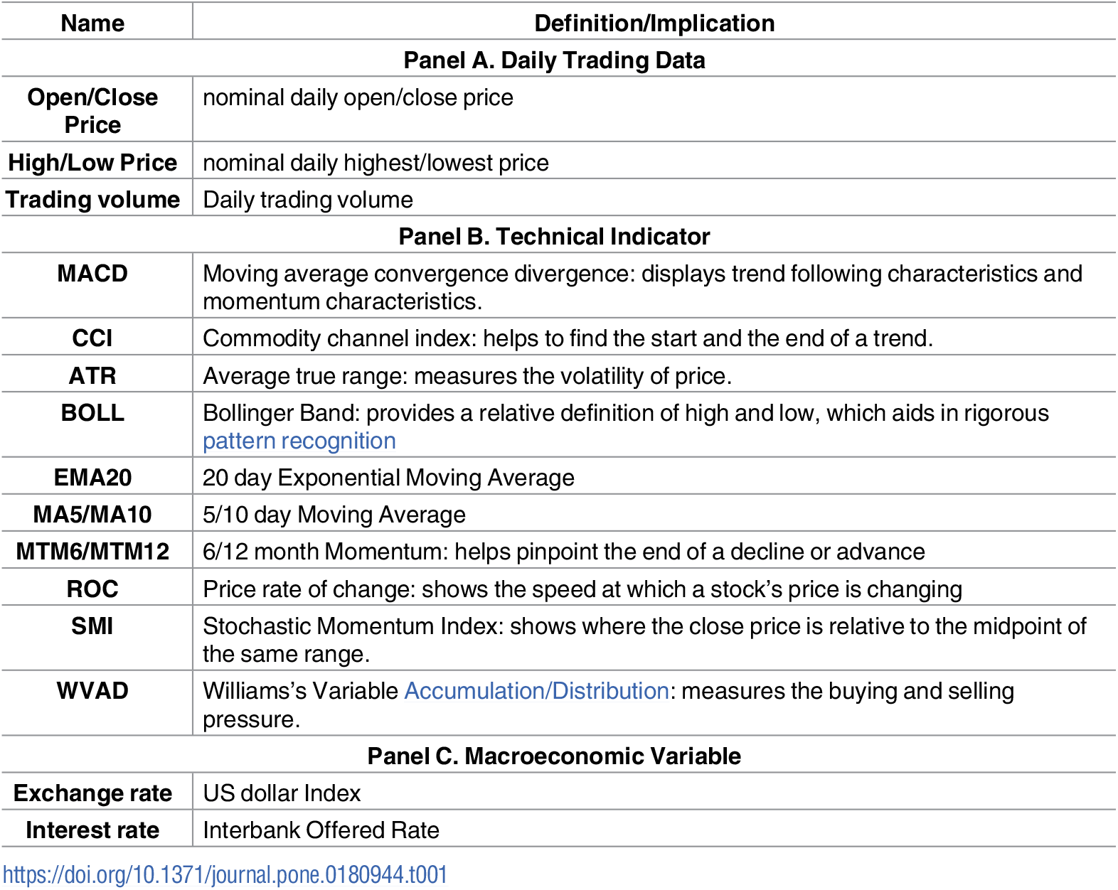
Data Description
The six stock indices we choose are CSI 300, Nifty 50, Hang Seng index, Nikkei 225, S&P500 and DJIA index. Market state may potentially impact the validity of the neural network.

Slide 22
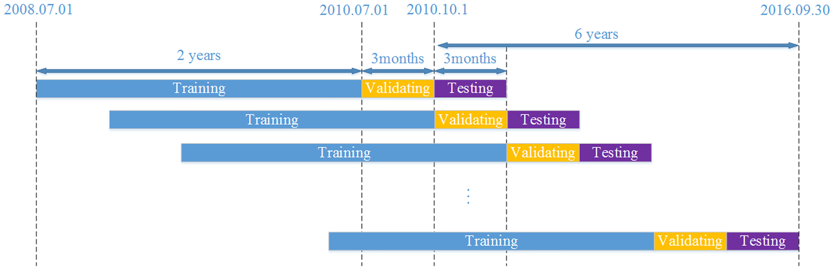
Prediction Approach
In particular, this procedure consists of three parts. The first part is the training part, which is used to train the model and update model parameters. The second part is the validating part. We use it to tune hyper-parameters and get an optimal model setting. The last one is the test part, where we use the optimal model to predict data. In the training part, we use the past two years’ worth of data to train the models. The following period of three months (a calendar quarter) is employed to the validating part. In the test part, in line with popular portfolio management practice, we predict the quarterly performance of each model. This process continues for six years on each quarter from Oct. 2010 to Sep. 2016. Finally, for each stock index, there are 24 quarterly and 6 yearly predicted results.

Slide 23
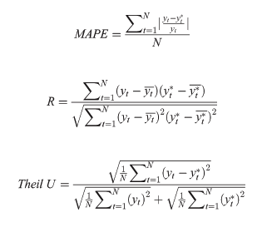
Predictive accuracy performance
The paper chose Mean Absolute Percent Error(MAPE) , R and Theil U to measure the predictive accuracy of each model. MAPE measures the size of the error. It is calculated as the relative average of the error. R is a measure of the linear correlation between two variables. Theil U is a relative measure of the difference between two variables. It squares the deviations to give more weight to large errors and to exaggerate errors. If R is bigger, it means that the predicting value is similar to the actual value, while if MAPE and Theil U are smaller, this also indicates that the predicted value is close to the actual value.

Slide 24
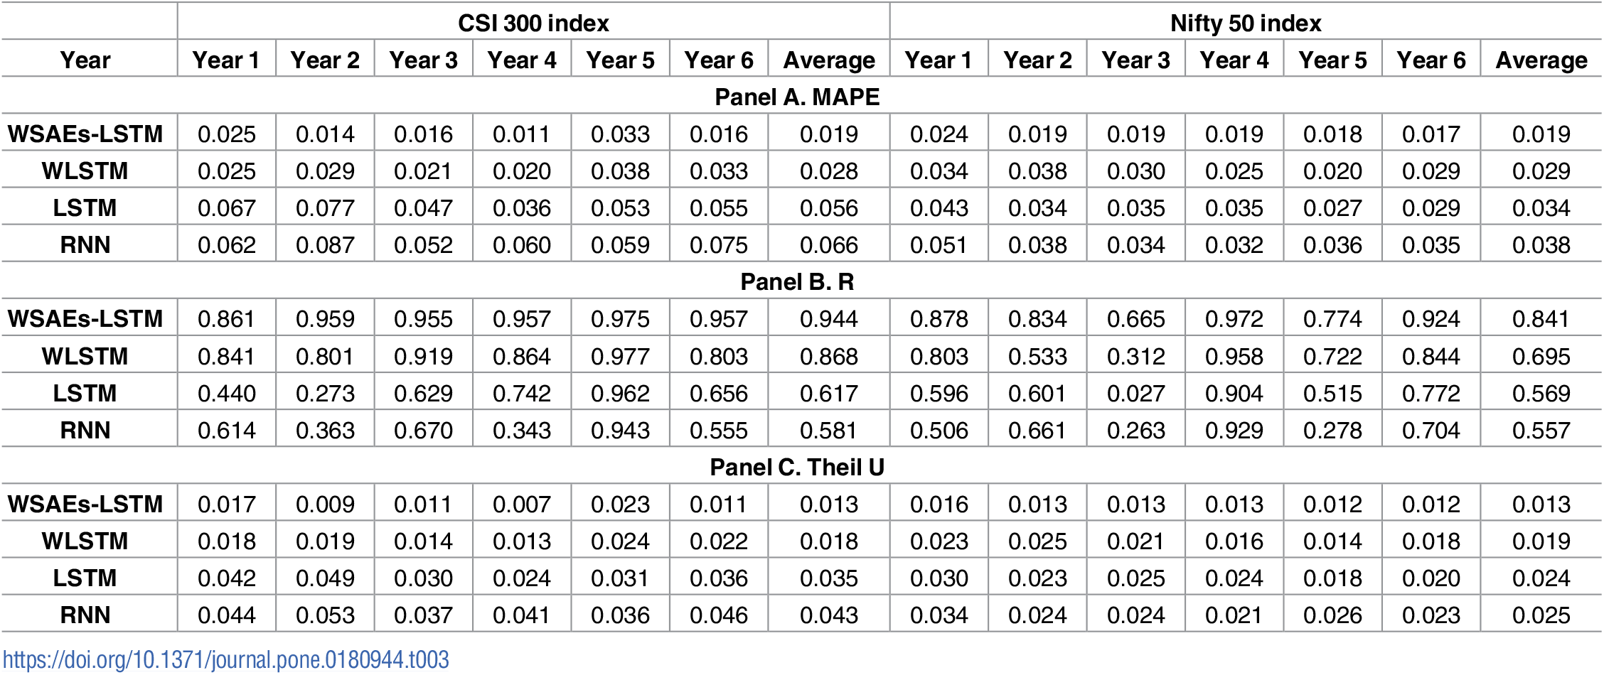
Result
It can be seen from the table that WSAEs-LSTM shows much better performance than the other three models in predicting both stock indices. For example, in predicting CSI 300 index, the average value of MAPE and Theil U of WSAEs-LSTM reach 0.019 and 0.013, respectively, which is much less than those of the other three models. Besides, the indicator R has an average value of 0.944, which is the highest one among the four models. In fact, WSAEs-LSTM outperforms the other three not only on average but also in each year

Slide 25
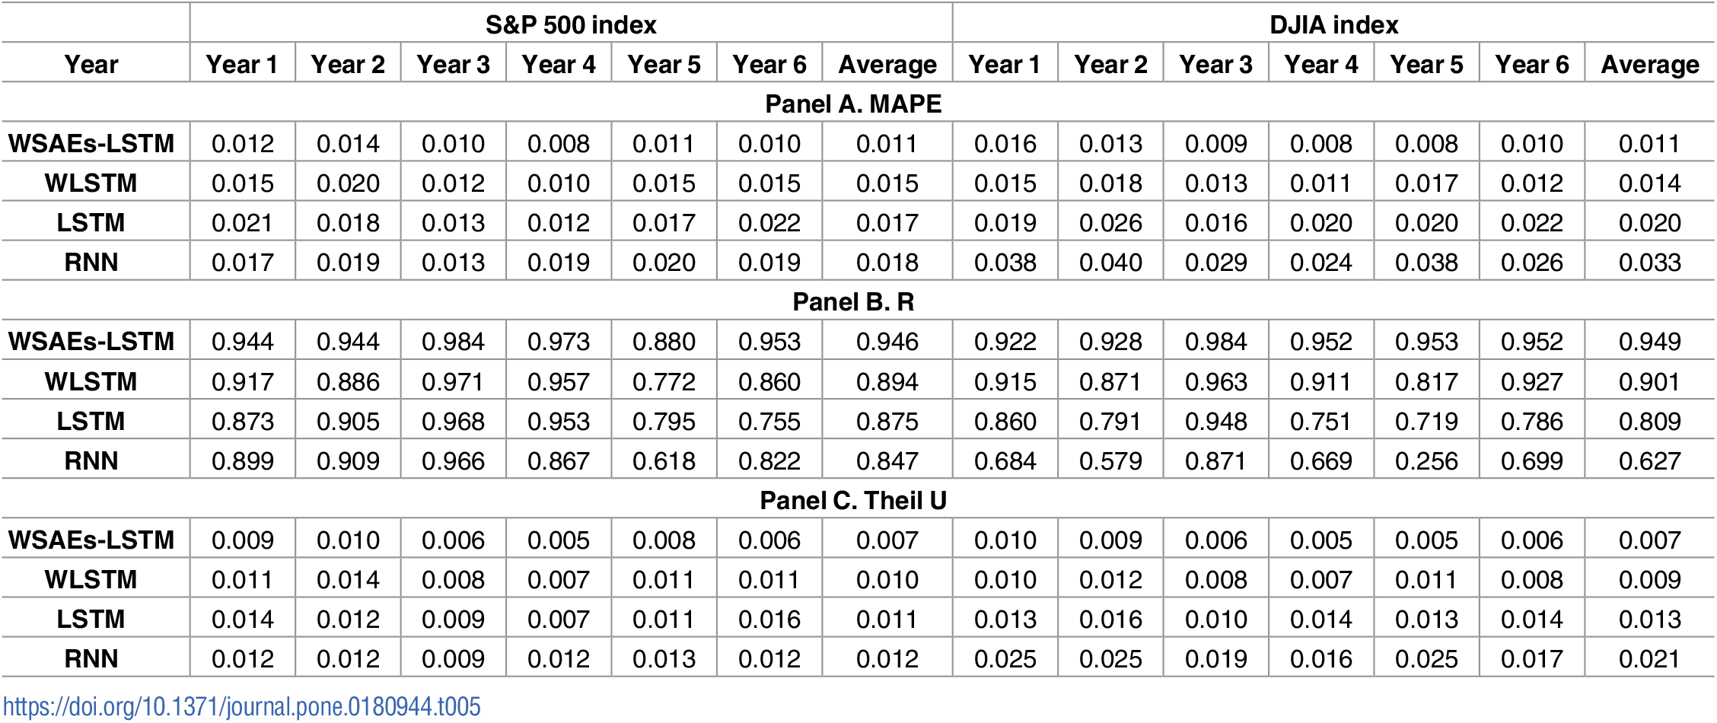

Result
Similar to previous findings, WSAEs-LSTM still has the lowest MAPE and Theil U and the highest R than the other three models not only from the perspective of average value but also from the perspective of yearly results.

Slide 26
Other related research
LSTM neural network with emotional analysis for prediction of stock price
A deep learning framework for financial time series using stacked autoencoders and long-short term memory
https://journals.plos.org/plosone/article?id=10.1371/journal.pone.0180944#pone.0180944.ref032
Forecasting stock markets using wavelet transforms and recurrent neural networks: An integrated system based on artificial bee colony algorithm
https://www.sciencedirect.com/science/article/abs/pii/S1568494610002565

